Slide 1

Michigan Real Estate Price Predictor Models
Justin Clawson
Joel Fisher
Cole O’Neill
Selena Passeno
Zac Williams

Slide 2

Project Overview
Project Description
We used housing market data to try to predict the sale price of houses in Michigan based on factors like square footage, location, bedrooms and bathrooms, lot size, and zip code.
Data Source
Downloaded from Kaggle
USA Real Estate Dataset
Realtor.com
ETL Process
Downloaded data, cleaned to include Michigan only
Drop duplicates and unneeded fields
Loaded to Spark SQL database

Slide 3








Tools Used

Slide 4
The Cleaned Data
How much data are we working with?
Original data = 1,084,909 rows, 12 columns
Cleaned (MI only) data = 22,076 rows, 11 columns
Removed prev. sold date, duplicates, excluded houses to build
Fun facts
484 square miles worth of property for sale in Michigan!
Harbert, MI has highest avg price ($2.6M) –I94 just north of IN border
Just over $7B in real estate total
Other tidbits
Average house size 1,880 sq. ft., median 1,584
Average price about $318,000, median price $210,000

Slide 5
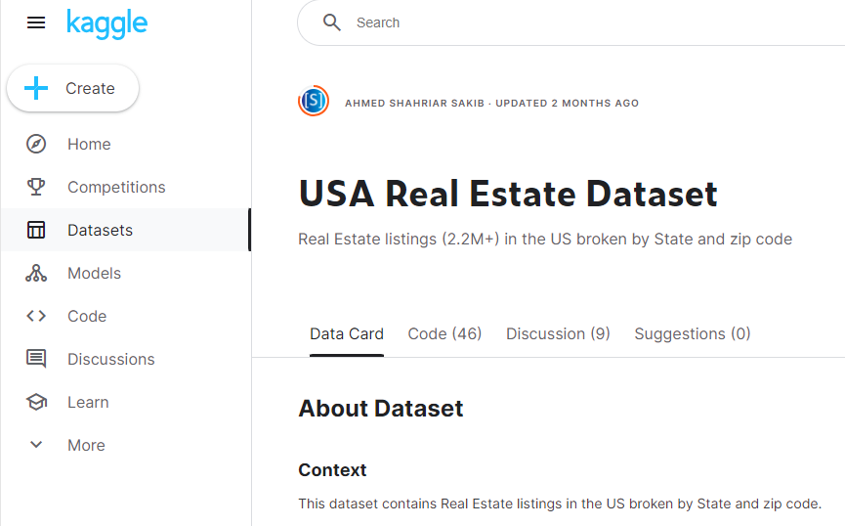
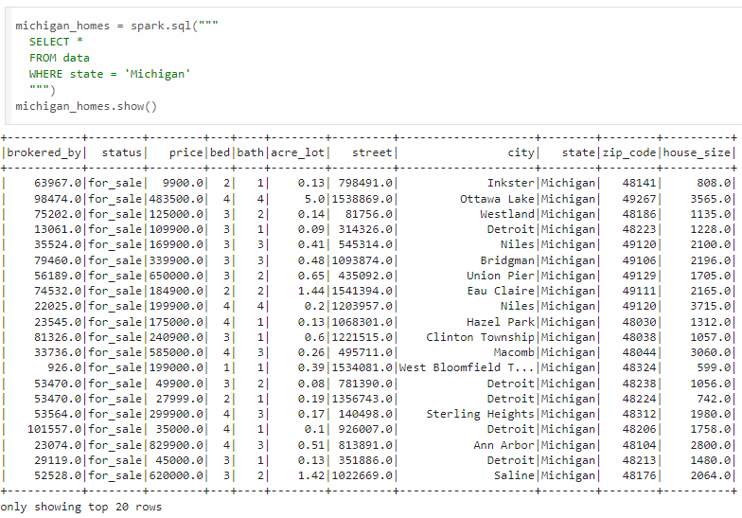

ETL Process

Slide 6

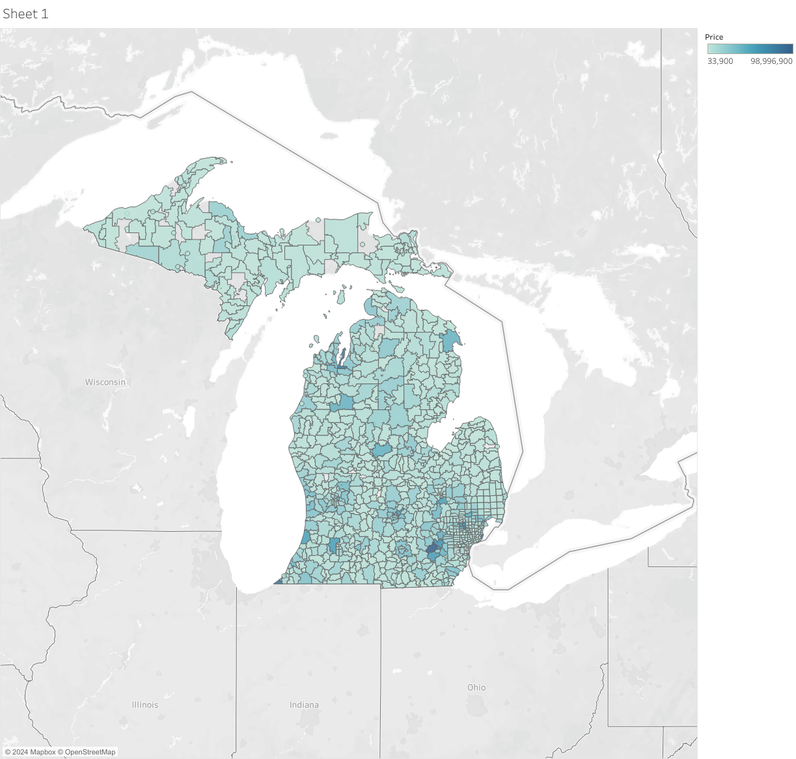
Tableau Visualization
Darker green = higher price
Grey counties = no data
Highest prices seen in the Ann Arbor area

Slide 7
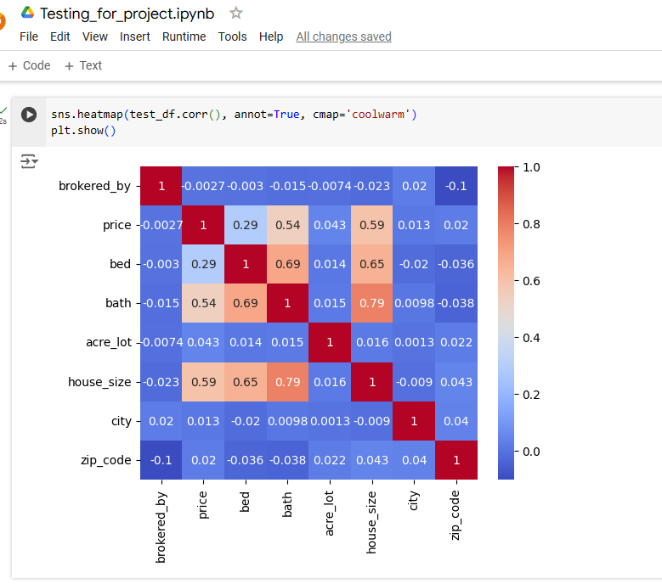
This code shows us the correlation between all variables in the data
Correlation Heatmap
Gives us an idea of what variables will be the most successful in models
Expect high correlation between price, house size and number of bed/bath rooms
https://www.freecodecamp.org/news/

Slide 8
Models
Linear Regression
Linear regression model used to predict price based on zip code, bed, bath, acreage, and house size
Decision Tree
With sklearn, used beds, baths, acreage, square footage, and zip code as features and price as target
Neural Networks
Attempted running several different versions and variations
Model used beds, baths, and house size to predict price
Random Forest
Using Pyspark, predicted price with beds, baths, acreage, zip code, square footage, and broker

Slide 9
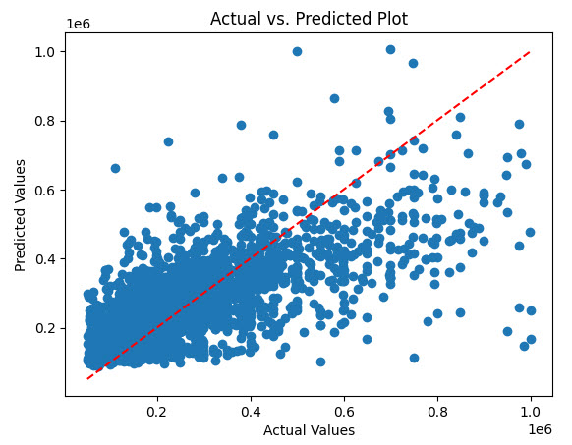
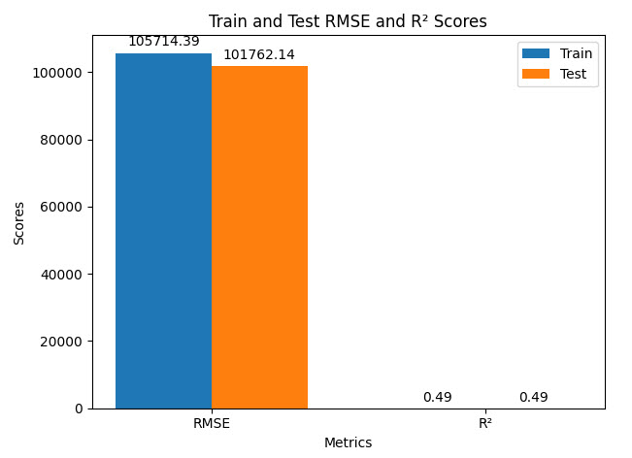
Linear Regression Model
Notes:
Sklearn, pandas, colab

Slide 10
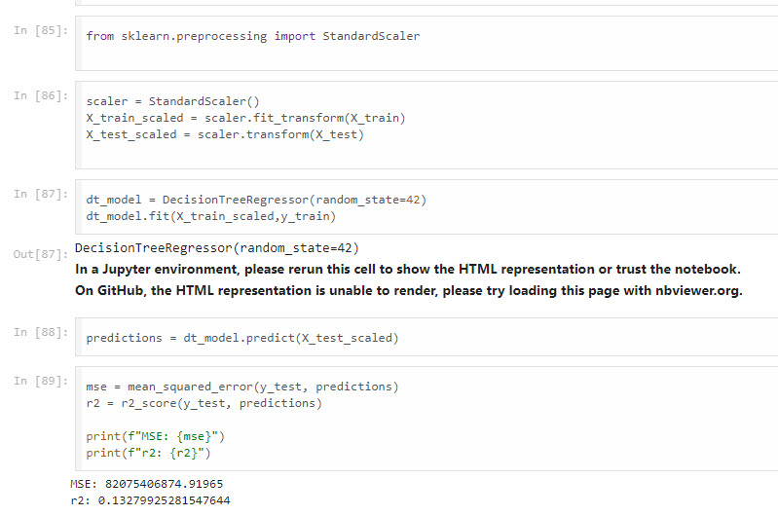
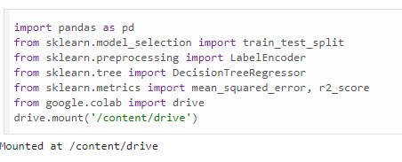
Decision Tree Model

Slide 11
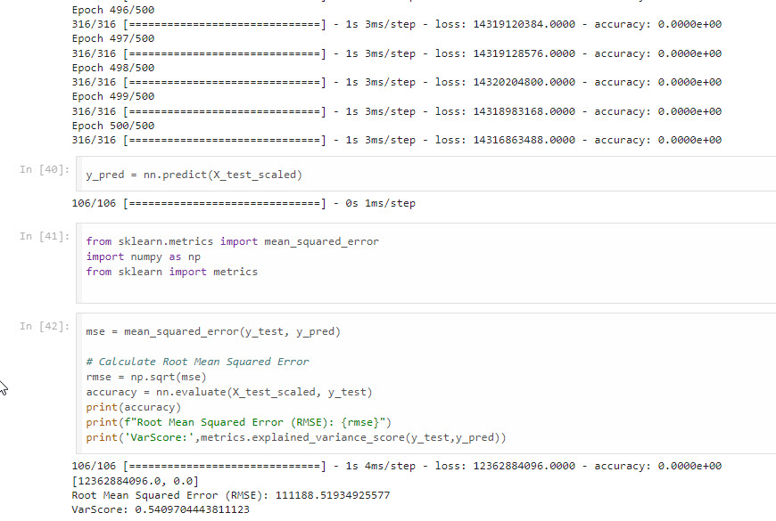
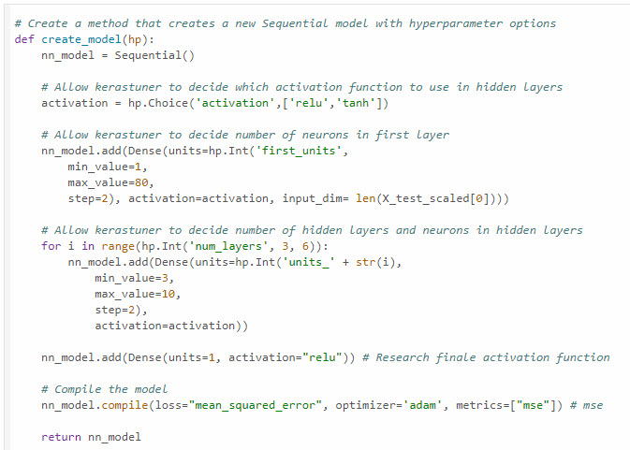
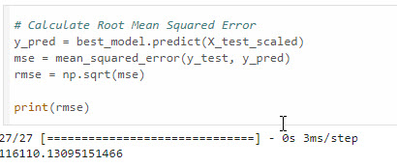
Neural Network Models
Version 1
Version 2

Slide 12
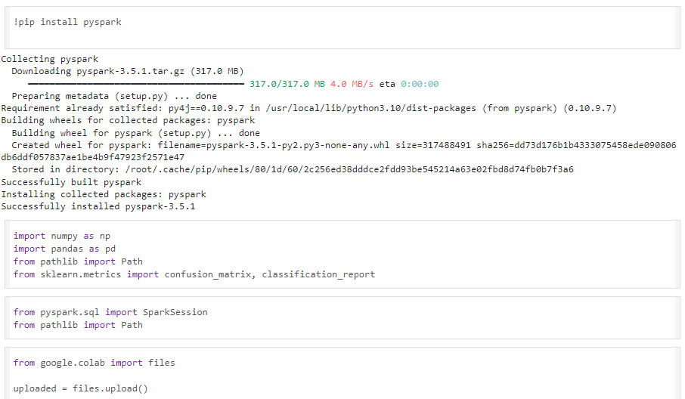
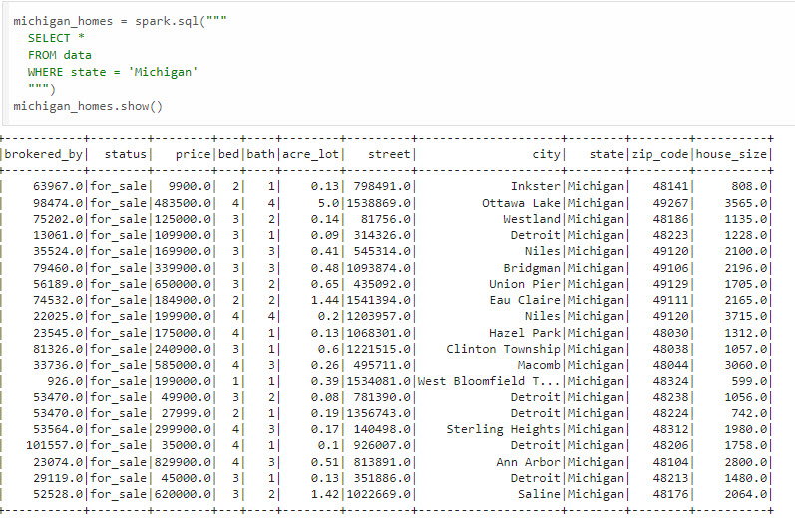
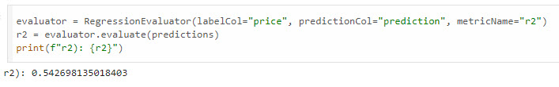
Random Forest Model

Slide 13
The Results & Best Model
Performed testing using 5 methods and multiple iterations of each to help optimize models
Neural Networks produced the best results (smallest RSME)
Second best would be Linear Regression

Slide 14




Project Conclusions
Best Model – Neural Networks
We ran several types of models, optimizing and running multiple iterations, and the neural network approach was the best.
Trying a variety of approaches, and performing optimization operations, let us find the best way to analyze the realtor data.
Tools We Used
We utilized Jupyter Notebook, Pandas, Python, Tableau, Sklearn, Colab, PySpark and SparkSQL to create five models designed to predict housing prices in Michigan.
We now have more tools at our disposal!
Other Considerations
Additional testing using other models may have resulted in a lower RMSE (time series or other)
Earlier use of heat map tool would have allowed us to see that data not highly correlated.
Could have used different or more expansive data which would have allowed model to train/test more
01
02
03

Slide 15
Thank You

